Slide 1

Sirius Snow Day Work
Tuesday 7th January 2025

Slide 2
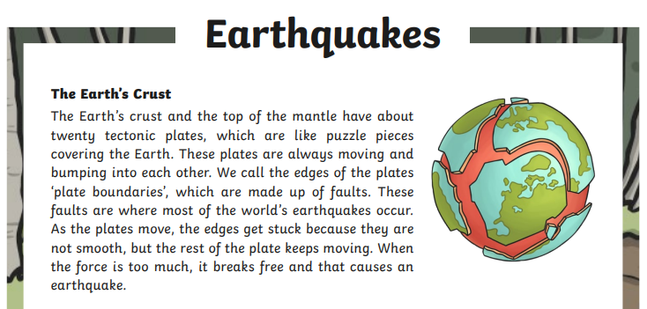
English Comprehension
Read the text and answer the questions.

Slide 3
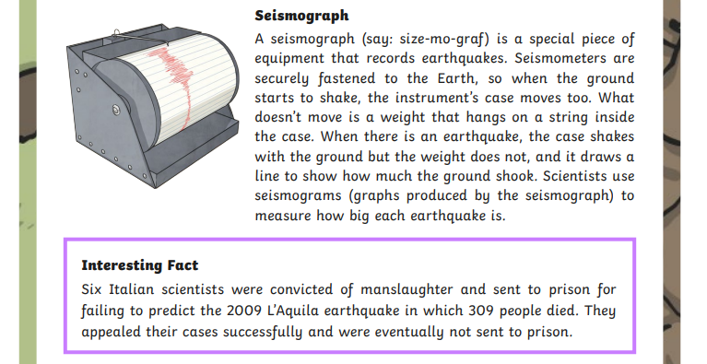

Slide 4
Questions:

Slide 5
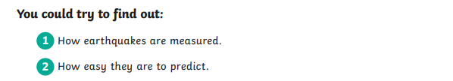
Extra task:

Slide 6
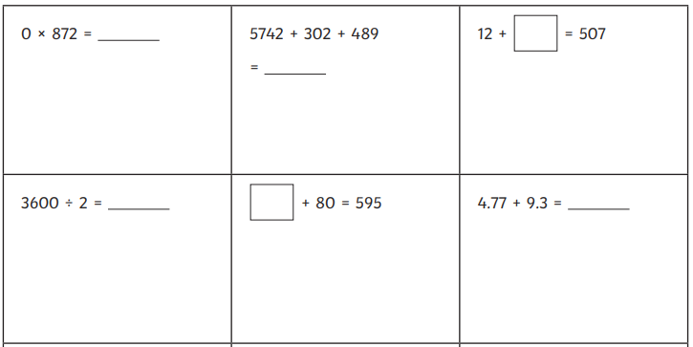
Maths Arithmetic

Slide 7
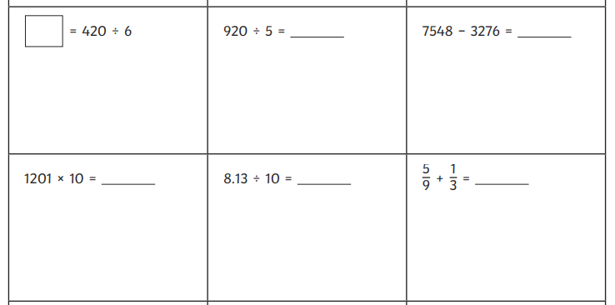

Slide 8
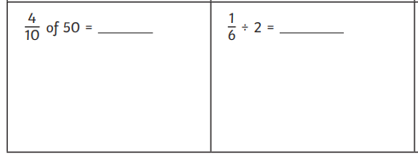
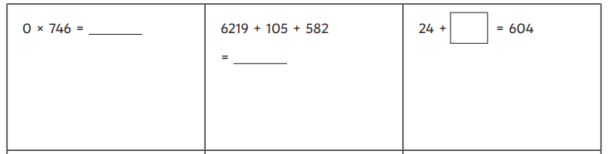

Slide 9
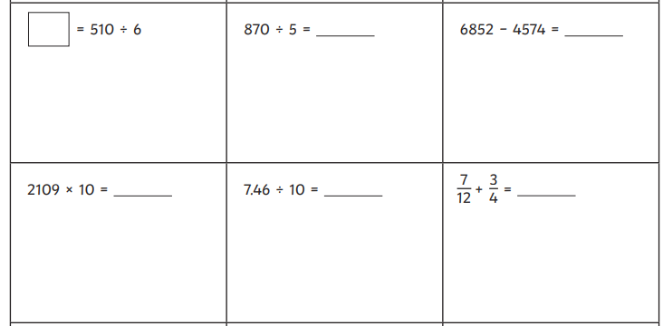

Slide 10
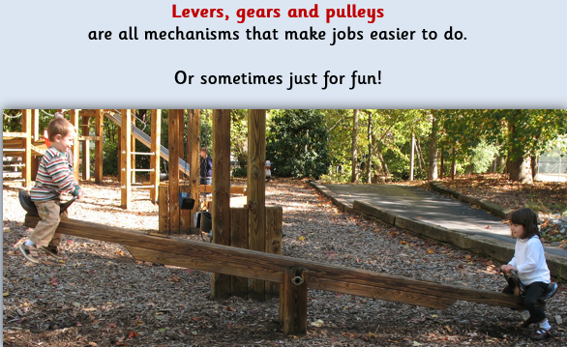
Design & Technology
Our learning this term will be about levers, gears and pulleys.

Slide 11
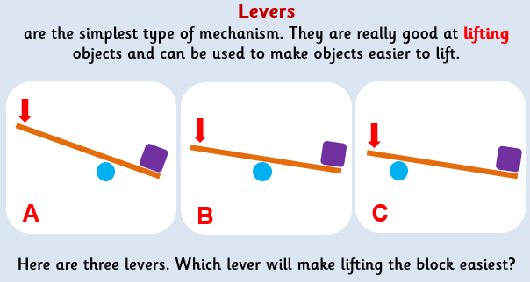
Design & Technology

Slide 12
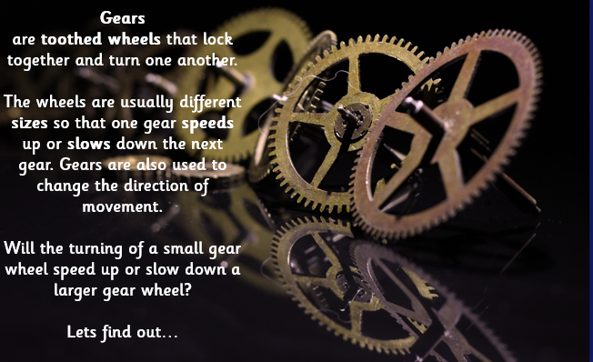
Design & Technology

Slide 13
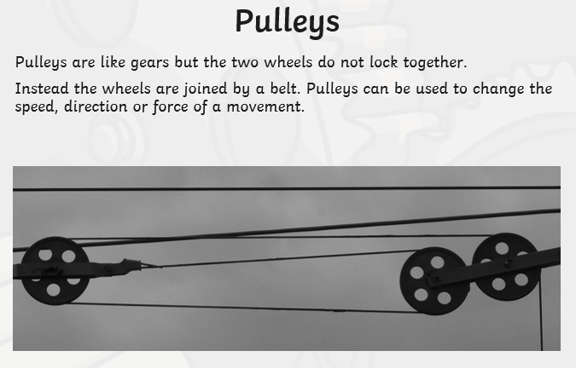
Design & Technology

Slide 14
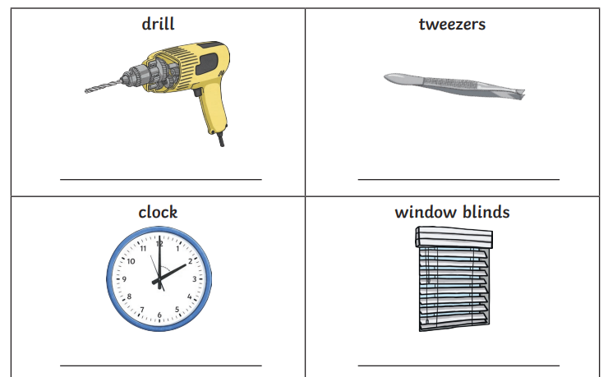
Design & Technology
Look at the images and decide whether they are examples of levers, pulleys or gears.

Slide 15
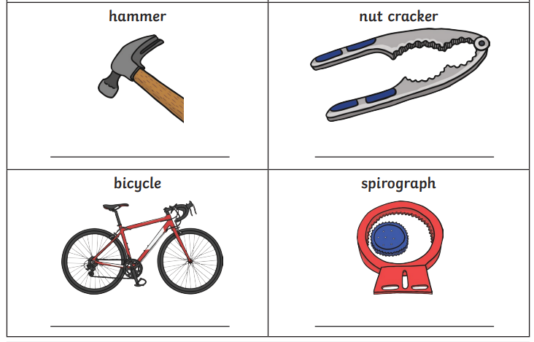
Design & Technology
Look at the images and decide whether they are examples of levers, pulleys or gears.

Slide 16
Design & Technology
Can you find any examples of levers, pulleys or gears around your house?

Slide 17


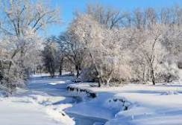
Extra Tasks
Practise your times tables on TT Rockstars
Read your reading book
Enjoy the snow while it lasts!

