Slide 1
Year 2 Home learning
English – different types of verbs

Slide 2

Year 2 – Spring Block 1 – Word Classes – Different Types of Verbs
Notes and Guidance:
From Autumn Block 3, children should be able to recognise and use nouns and adjectives.
Some children may have heard the term ‘verb’ (this is included in our Year 1 coverage) but this may be unfamiliar.
In this step, children will learn to identify a verb within a sentence and begin to distinguish between different types of verbs:​
  Action verbs are commonly called ‘doing words’ because they name an action that someone does, for example: Tyler ran for the bus. Note that this can be a way of recognising verbs but it doesn’t reliably distinguish verbs from nouns, as nouns can be used to name the action, for example: The run for the bus was tiring. This distinction may not be necessary for Year 2 but equally can be a misconception.
  The verb ‘to be’ which describes a state of being, for example: Tom is nine years old.
  Linking verbs which links the noun (or pronoun) to the rest of the sentence, for example: She likes ice cream.
  Please note: In the lesson resource pack for this step, Greater Depth will look at using more than one verb in a sentence, but it will not look at defining the verb forms such as participle. This will be covered in later years.
Focused Questions​
​
Does this verb describe an action or state?
Identify the verb in this sentence.
What type of verb is used in the sentence?​
© Classroom Secrets Limited 2018

Slide 3
Year 2 – Spring Block 1 – Word Classes
Step 1: Different Types of Verbs
© Classroom Secrets Limited 2018

Slide 4
Introduction
Identify the nouns and adjectives in these sentences.
A) The tall girl kicked the football.
B) Katie was happy.
C) London looks busy.
© Classroom Secrets Limited 2018

Slide 5
Introduction
Identify the nouns and adjectives in these sentences.
A) The tall girl kicked the football.
B) Katie was happy.
C) London looks busy.
A) Nouns: girl, football
B) Noun: Katie
C) Noun: London
© Classroom Secrets Limited 2018

Slide 6
Introduction
Identify the nouns and adjectives in these sentences.
A) The tall girl kicked the football.
B) Katie was happy.
C) London looks busy.
A) Adjective: tall
B) Adjective: happy
C) Adjective: busy
© Classroom Secrets Limited 2018

Slide 7
Varied Fluency 1
The verbs are underlined in this sentence.
True or false?
The green leaf bent when the beetle ran across it.
© Classroom Secrets Limited 2018

Slide 8
Varied Fluency 1
The verbs are underlined in this sentence.
True or false?
The green leaf bent when the beetle ran across it.
True
© Classroom Secrets Limited 2018

Slide 9
Varied Fluency 2
Tick the type of verb in each sentence.
Sentence | Action | To be | Linking
1. Tomorrow is my birthday.
2. Georgia watches football on the TV.
3. The sunflower looks taller than the house.
© Classroom Secrets Limited 2018

Slide 10
Varied Fluency 2
Tick the type of verb in each sentence.
Sentence | Action | To be | Linking
1. Tomorrow is my birthday. |  | ✔
2. Georgia watches football on the TV. | ✔
3. The sunflower looks taller than the house. |  |  | ✔
© Classroom Secrets Limited 2018

Slide 11
Varied Fluency 3
Which sentence uses a ‘to be’ verb?
A) I will take a coat if I am cold.
B) Yesterday, I hurried to the shop so I could buy some ingredients.
© Classroom Secrets Limited 2018

Slide 12
Varied Fluency 3
Which sentence uses a ‘to be’ verb?
A) I will take a coat if I am cold.
B) Yesterday, I hurried to the shop so I could buy some ingredients.
A
© Classroom Secrets Limited 2018

Slide 13
Varied Fluency 4
Use a linking verb to complete the sentence below.
The towels ________ warm when I take them out of the dryer.
© Classroom Secrets Limited 2018

Slide 14
Varied Fluency 4
Use a linking verb to complete the sentence below.
The towels ________ warm when I take them out of the dryer.
Various answers, for example:
The towels feel warm when I take them out of the dryer.
© Classroom Secrets Limited 2018

Slide 15
Application 1
Give three different ways you could complete this sentence. Say which type of verb you have used.
The cream cake _______ scrumptious.
© Classroom Secrets Limited 2018

Slide 16
Application 1
Give three different ways you could complete this sentence. Say which type of verb you have used.
The cream cake _______ scrumptious.
Various answers, for example:
The cream cake was scrumptious. To be
The cream cake looked scrumptious. Linking
The cream cake tasted scrumptious. Linking
© Classroom Secrets Limited 2018

Slide 17
Application 2
Marlie has started writing a sentence.
They were angry that the dog …
Complete the sentence using the linking verb ‘looked’.
© Classroom Secrets Limited 2018

Slide 18
Application 2
Marlie has started writing a sentence.
They were angry that the dog …
Complete the sentence using the linking verb ‘looked’.
Various answers, for example:
They were angry that the dog looked muddy.
They were angry that the dog looked filthy.
© Classroom Secrets Limited 2018

Slide 19
Reasoning 1
Elliott has written this sentence.
They were delighted that the cake tasted good.
He thinks that he hasn’t used any action verbs. Is he correct? Explain your answer.
© Classroom Secrets Limited 2018

Slide 20
Reasoning 1
Elliott has written this sentence.
They were delighted that the cake tasted good.
He thinks that he hasn’t used any action verbs. Is he correct? Explain your answer.
Yes because…
© Classroom Secrets Limited 2018

Slide 21
Reasoning 1
Elliott has written this sentence.
They were delighted that the cake tasted good.
He thinks that he hasn’t used any action verbs. Is he correct? Explain your answer.
Yes because ‘were’ is a ‘to be’ verb and ‘tasted’ is a linking verb.
© Classroom Secrets Limited 2018

Slide 22
Year 2 Home learning
Maths – 3D shapes

Slide 23
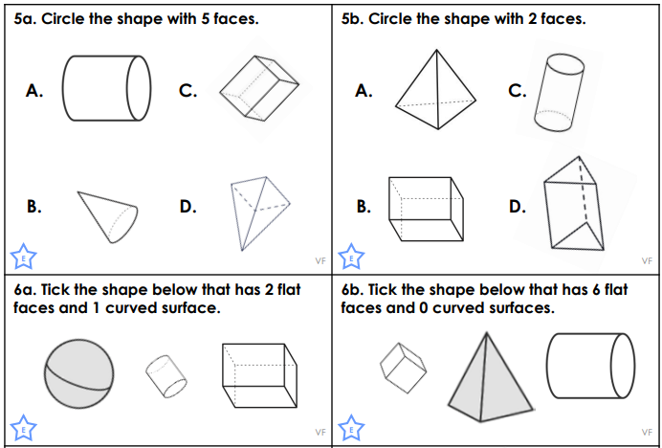
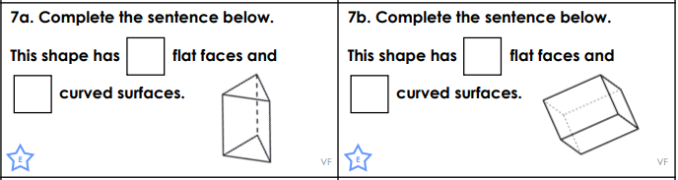
B) Complete the activities on the following link and answer the questions below. What are the properties of 3D shapes? - BBC Bitesize

Slide 24
Year 2 Home learning
Geography – Mega structures​

Slide 25
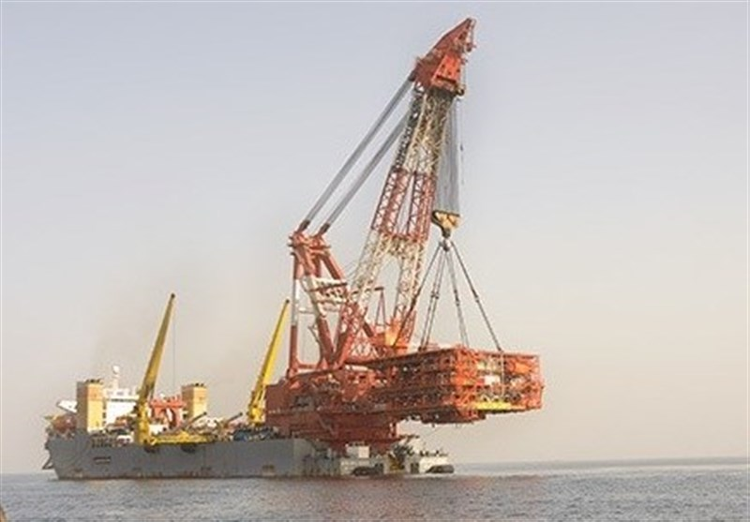
Megastructures
What are they and why are they important?
Notes:
“Today, we’re going to learn about megastructures. These are some of the biggest and most impressive structures humans have built. Let’s explore what makes them special and why they matter.”

Slide 26
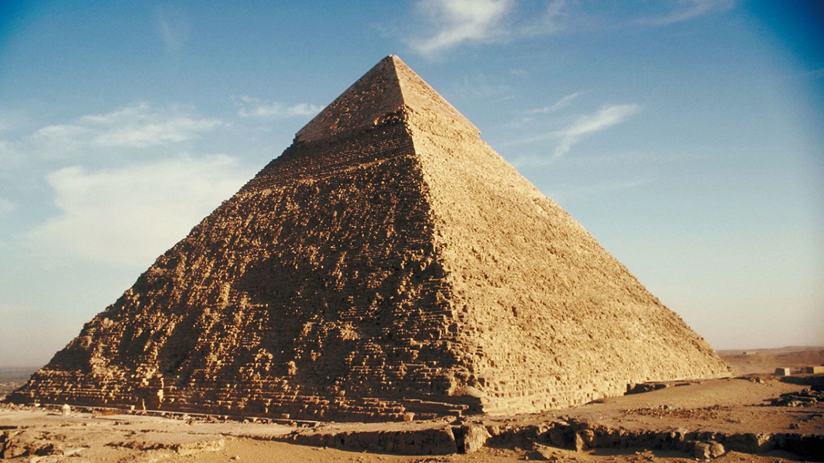
A megastructure is a very large and impressive building or structure made by humans.
They are –
Large
Complex
Serve a purpose
Notes:
A megastructure is not just big—it’s designed to solve problems or make life better. Let’s think about what purposes these structures might serve.

Slide 27
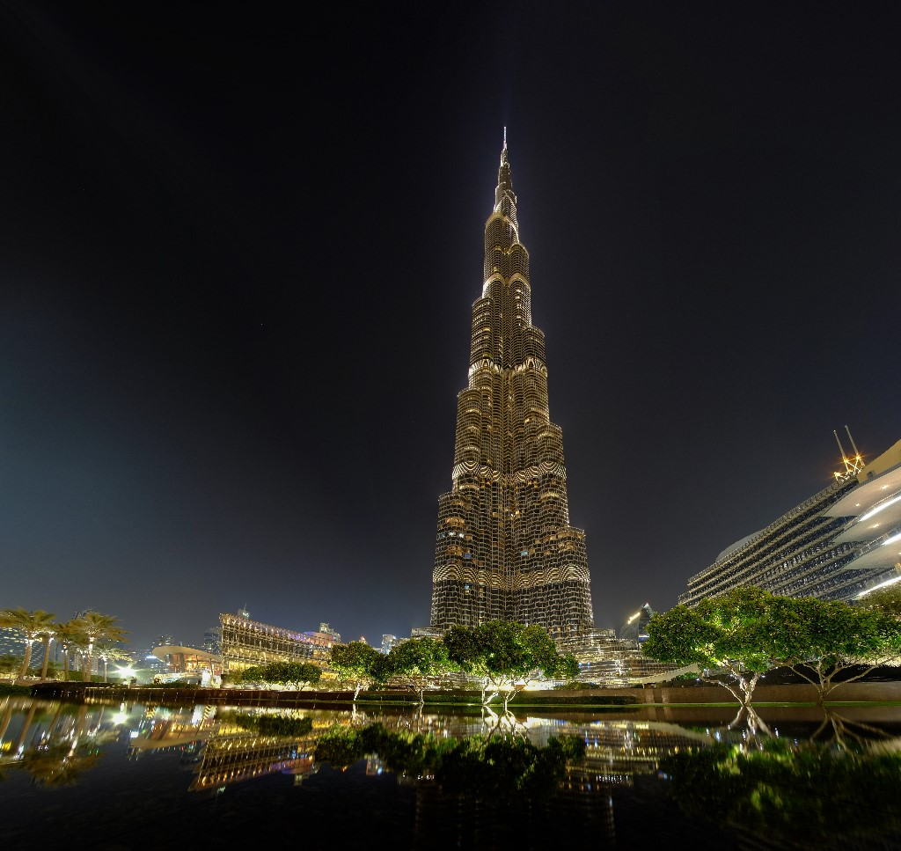
Burj Khalifa
The Burj Khalifa is the tallest building in the world, shaped like a shiny rocket reaching into the sky. It's in Dubai and has places to live, work, and visit. A super-fast lift takes you to the top, where you can see for miles, like a bird. At night, it sparkles with lights and has amazing shows with fountains that dance!
Notes:
A megastructure is not just big—it’s designed to solve problems or make life better. Let’s think about what purposes these structures might serve.

Slide 28
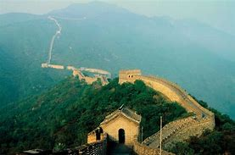
The Great Wall of China
The Great Wall of China is a giant wall that stretches across hills and valleys, winding like a long dragon. It was built a very long time ago to protect people and help soldiers see far away. The wall is so big you could walk on it for days! It’s made of stones and bricks, with watchtowers along the way. Today, people visit to see its amazing size and learn about its history. It’s one of the world’s most famous landmarks!
Notes:
A megastructure is not just big—it’s designed to solve problems or make life better. Let’s think about what purposes these structures might serve.

Slide 29
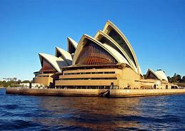
The Sydney Opera House
The Sydney Opera House is a famous building in Australia that looks like giant white sails or seashells floating on the water. It’s by the Sydney Harbour and is used for concerts, plays, and shows.
Notes:
A megastructure is not just big—it’s designed to solve problems or make life better. Let’s think about what purposes these structures might serve.

Slide 30
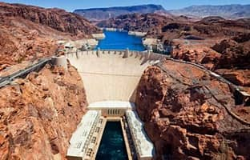
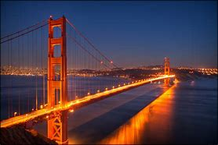
What makes them special?
Solve problems
Help people
Notes:
“Megastructures stand out because they’re designed to solve big problems or serve large groups of people. Think about bridges—what problems do they solve?”

Slide 31
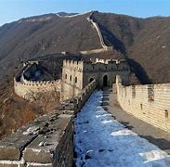
The great wall of China is over 13000 miles long.
Provides power to over 1 millions homes.
Notes:
“Megastructures stand out because they’re designed to solve big problems or serve large groups of people. Think about bridges—what problems do they solve?”

Slide 32
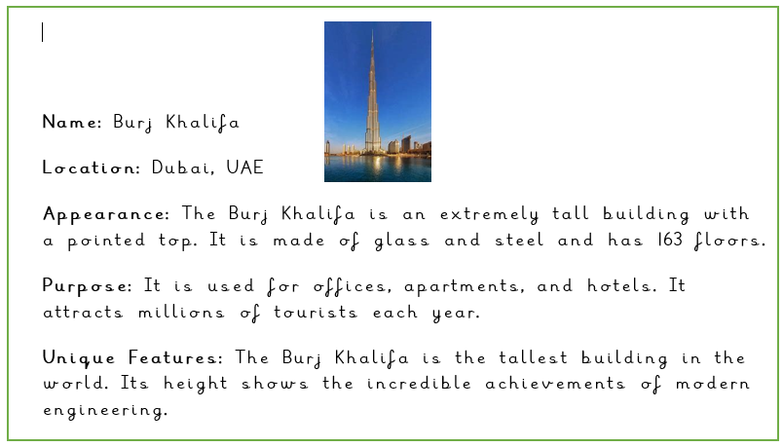
Read the information about the Burj Khalifa and answer the questions on the next slide.

Slide 33
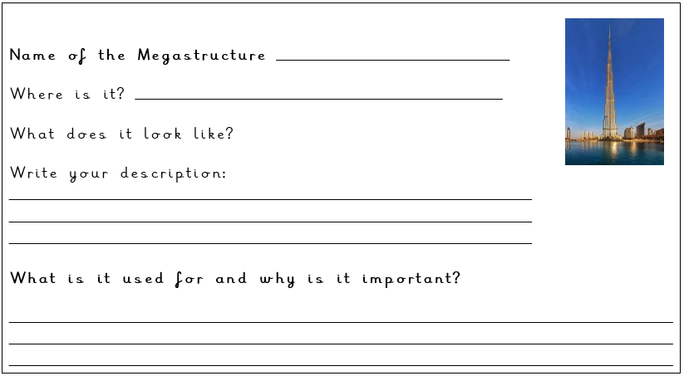

Slide 34
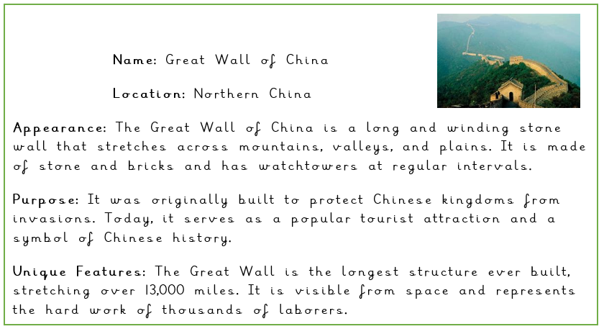

Slide 35
